Slide 1
DIP Final Presentation Image Morphology Team: The Big Dipper
Team Members: Patrick Byrnes, Daria Martin, Jeffry Sandoval, Jeffrey Pernia, Chinemerem Njoku, Austin Ma, And Rami Ghannam

Slide 2
Refined Objectives
To create an application with a basic GUI that shows the effects of Erosion, Dilation, Opening, Closing, Open-Close, Close-Open, Boundary Extraction, and Skeletonization on any image the user inputs.
We will take in any image, convert it to a binary image and perform all of the mentioned morphological operations.
We also plan to perform Erosion and Dilation operations on greyscale images.
In addition to bimodal thresholding, we plan to implement OTSU thresholding to binarize our input images.
This application can be used to study and better understand the concepts within Image Morphology. There is the added benefit of being able to improve images, such as those with noise.

Slide 3
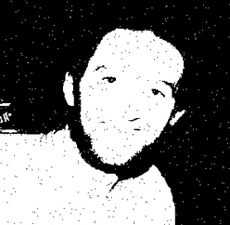
Motivations for Objectives
Image Morphological Operations have useful practical applications. For instance, it can be used to reduce noise in an image. By performing opening followed by closing we will be able to smooth this noisy image in our application.

Slide 4
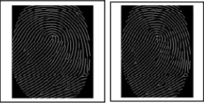
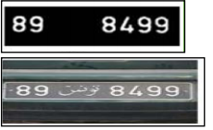
Motivations (cont.)
Other examples of practical applications of image morphology include fingerprint feature extraction, text extraction, and license plate extraction.

Slide 5
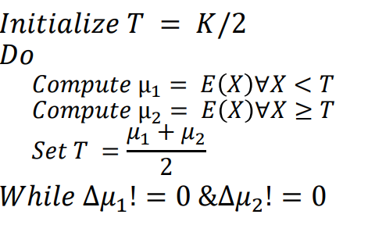
Implementation and Approach: Thresholding and Binarizing
After taking in the input image and converting it to greyscale, we compute the histogram of this grayscale image in order to determine the threshold.
Our approach for finding the threshold assumes a bimodal histogram. We use the following algorithm.
After determining the threshold, we compute the binary image.
We have still yet to implement OTSU thresholding, but it will be in the final version of our application.

Slide 6

Implementation and Approach: Dilation, Erosion, Open, Close
Our implementation uses a 5 pixel cross structuring element for both dilation and erosion.
Once a pixel is iterated over, we apply an OR operation in the range of the cross if we want to dilate. If we want to erode, we use an AND operation.
Just like how we learned in class, once we have Dilation and Erosion they are used as the building blocks for other morphological operations.
For Close we first applied our dilation function, then our erosion function. Erode(Dilate(img))
For Open we first applied our erosion function, then our dilation function. Dilate(Erode(img))
Close-Open and Open-Close build on the previous operations as well:
Close-Open: Close(Open(img))
Open-Close: Open(Close(img))

Slide 7
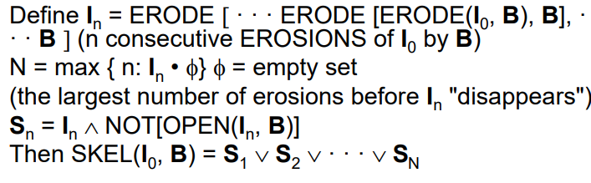
Implementation and Approach: Skeletonization
Our process for Skeletonization follows the algorithm is to erode the image right before it disappears. We then perform an AND operation with a NOT(Open()), each of these is stored as a part of the skeleton. Then the Skeleton is produced by combining all of the previous pixels with an OR operation.

Slide 8
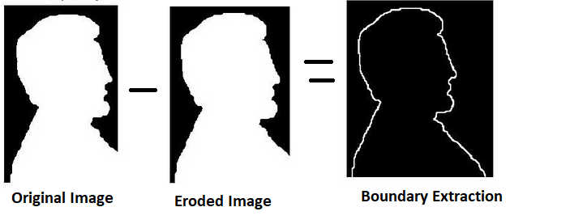
Implementation and Approach: Boundary Extraction
To implement boundary extraction we first eroded the image, then we subtracted this eroded image from the original image in order to show the boundaries.

Slide 9
Implementation and Approach: Roadblocks & Issues
With images that do not have a bimodal histogram, the threshold we select is not the most optimal. By implementing OTSU thresholding we should be able to select a better threshold for binarizing our images.
Our skeletonization function takes a while to process due to the storage of multiple images during calculation.

Slide 10
Further work
To achieve our objectives we are still in the process of completing the following:
OTSU thresholding
Erosion and Dilation on Greyscale images

Slide 11
Demo

Slide 12
Conclusion
Thank you for your time, we will now answer any questions.

